Slide 1
CSC 362: System Programming
Lecture 5
Original slides by: Amitabha Dey
Adapted by: Dr. Richard Johnson
Department of Computer Science University of North Carolina at Greensboro

Slide 2

Status Check
Understand git structure
Git commands:
SSH authentication
Initialize local repository
Adding files & commiting changes
Pushing files to remote repo
Pulling files from remote repo
What we will cover today
Pointers and Strings in C
Dynamic Memory Allocation
Common Bugs
Null Bytes
Double Frees
Dangling Pointers
Notes:
Topics Covered:
Pointers and strings in C,
dynamic memory allocation,
and common bugs like
null bytes,
double frees,
and dangling pointers.

Slide 3
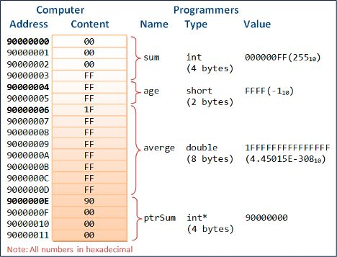
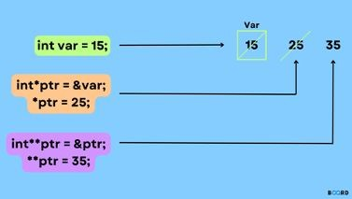
A computer memory location has an address and holds a content (hexadecimal representations of byte values).
Pointers in C
In C/C++, a pointer is a variable that holds the memory address of another variable. Pointers provide a way to work with memory directly and are a powerful feature of the language.
Image credit - https://www.boardinfinity.com/
Image credit - https://www3.ntu.edu.sg/
Notes:
Pointers in C
Definition:
A pointer is a variable that stores the memory address of another variable.
Function:
They allow direct memory manipulation, which is a powerful feature in C/C++.
Memory
Every memory location has a unique address and holds content, often represented as hexadecimal byte values.

Slide 4
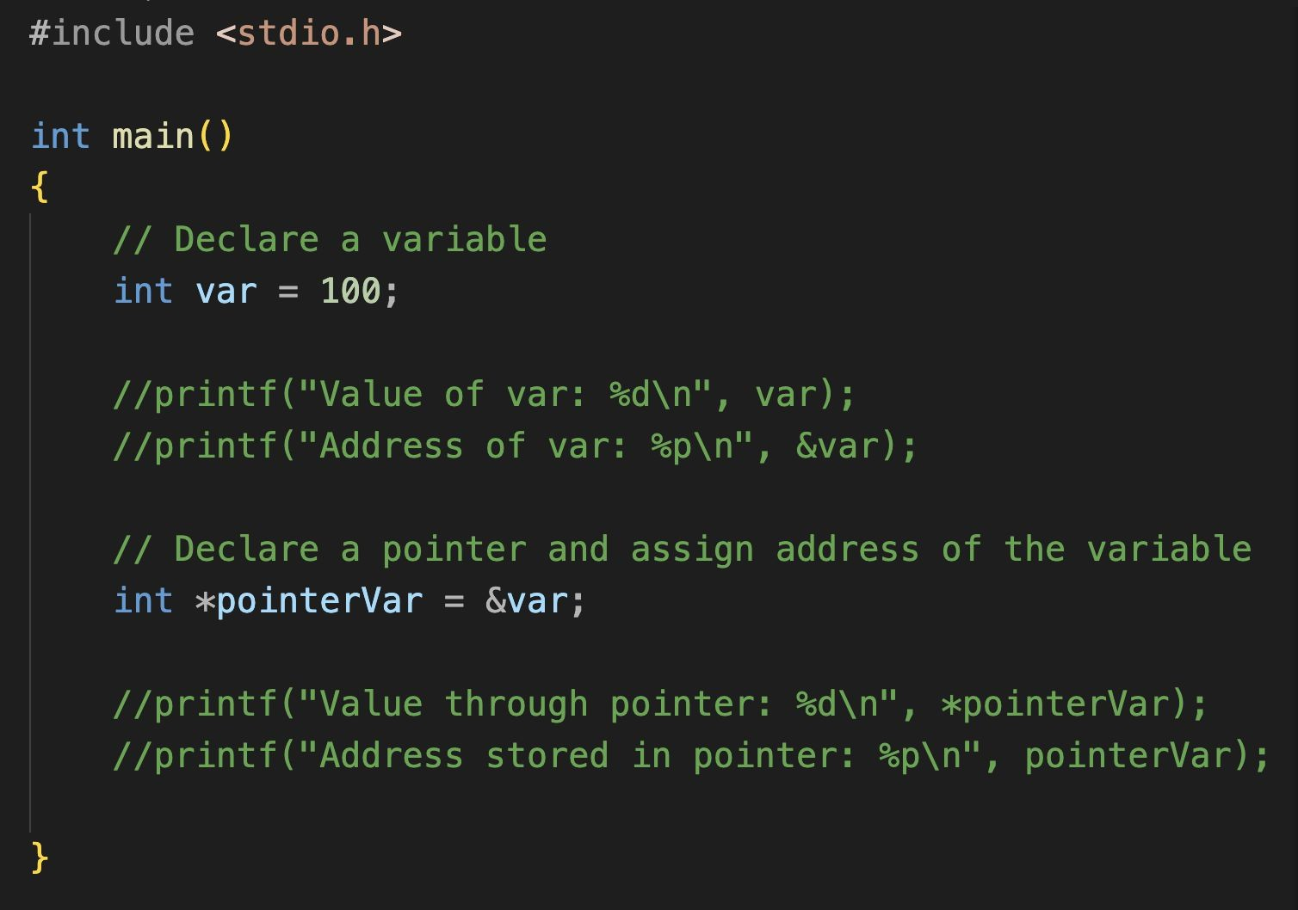
In-Class Activity Pointers in C
Value of var:
var
Address of var:
&var
*pointerVar = &var
Value through pointer:
*pointerVar
Address stored in pointer:
pointerVar
Notes:
Pointers in C
Variable Value: Accessed via the variable name (var).
Address of Variable: Obtained using the address-of operator (&var).
Pointer Assignment: A pointer is assigned an address using *pointerVar = &var.
Dereferencing: *pointerVar retrieves the value stored at the address.
Stored Address: pointerVar displays the actual address stored in the pointer.
See example:
pointer_intro.c
---
Long-form Description:
Basic Pointer Declaration
The image demonstrates the fundamental relationship between a variable and its pointer.
Variable Setup:
An integer var is initialized with the value 100.
Pointer Assignment:
A pointer pointerVar is declared and assigned the memory address of var using the & (address-of) operator.
Accessing Data:
The commented-out code suggests that *pointerVar would retrieve the value 100, while pointerVar itself holds the hexadecimal memory address.

Slide 5
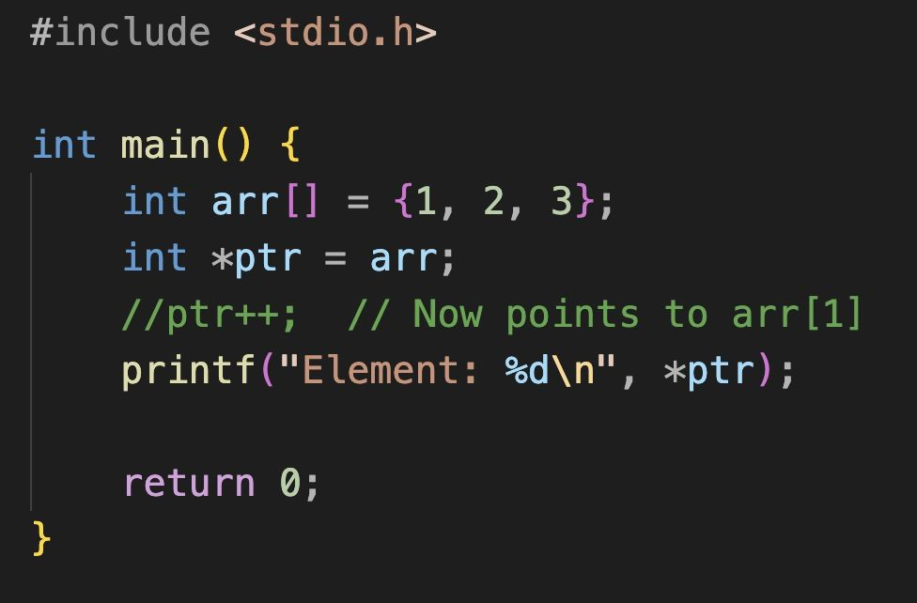
In-Class Activity
Pointer Arithmetic
Pointers can be incremented or decremented to point to the next or previous memory location.
Notes:
Pointer Arithmetic
Concept: Pointers can be incremented or decremented to move to the next or previous memory locations.
See example:
pointer_arithmetic_1.c
---
Long-form Description:
Pointers and Arrays
The image illustrates how an array name acts as a pointer to its first element.
Array Definition:
An array arr is created containing the elements {1, 2, 3}.
Pointer Link:
Setting int *ptr = arr makes the pointer point to the first element, arr[0].
Pointer Arithmetic:
A commented-out line ptr++ indicates that incrementing the pointer would shift it to point at the next element, 2 (arr[1]).

Slide 6
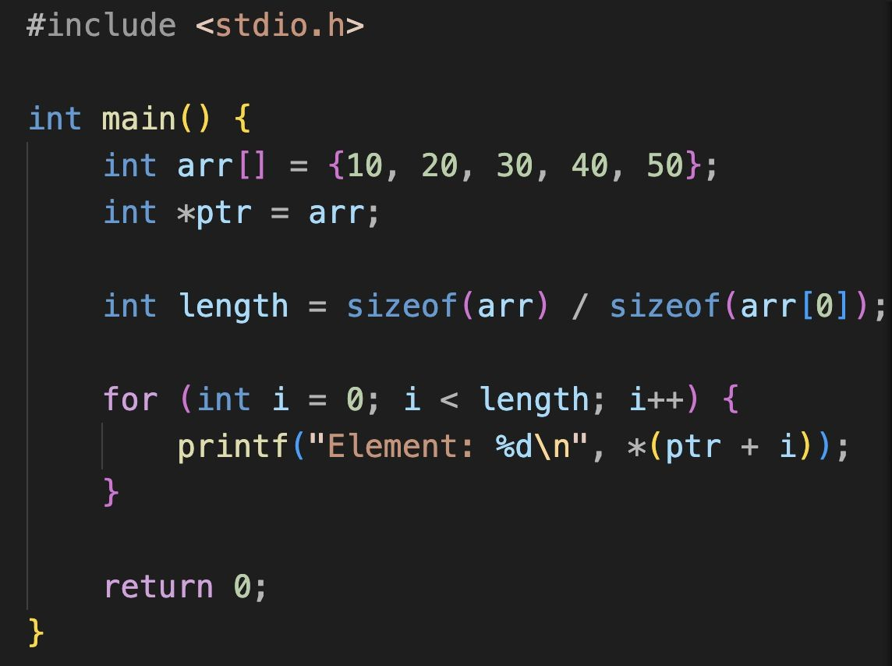
In-Class Activity
Pointer Arithmetic (2)
Iterate through the array using pointer arithmetic to access each element
Notes:
Pointer Arithmetic
Application: Pointer arithmetic is used to iterate through arrays to access individual elements.
See example:
pointer_arithmetic_2.c
---
Long-form Description:
Iterating with Pointer Arithmetic
The image shows a common pattern for traversing an entire array using a loop and pointer arithmetic.
Dynamic Length:
The code calculates the number of elements using sizeof(arr) / sizeof(arr[0]).
The Loop:
A for loop iterates through the array.
Dereferencing:
The expression *(ptr + i) is used to access each value by adding an offset to the base pointer and then dereferencing it.

Slide 7
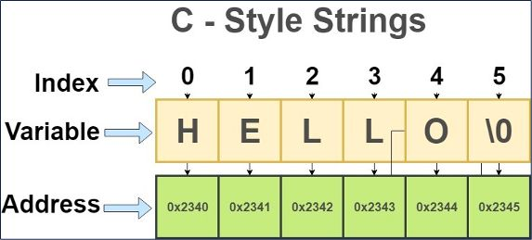
Strings in C
This C-style string is actually a one-dimensional array of characters which is terminated by a null character ‘\0’
C does not store the length of a string explicitly. The null character serves as a sentinel value that marks the end of the string.
Standard C string functions, like strcpy (copy), strcat (concatenate), and strcmp (compare), rely on the null character to identify the end of strings.
Image credit - simplesnippets.tec
Notes:
Strings in C
Structure:
C-style strings are one-dimensional character arrays terminated by a null character (\0).
Length:
C does not explicitly store string length;
it relies on the null character as a "sentinel value".
Functions:
Standard functions like strcpy, strcat, and strcmp require the null terminator to function.

Slide 8
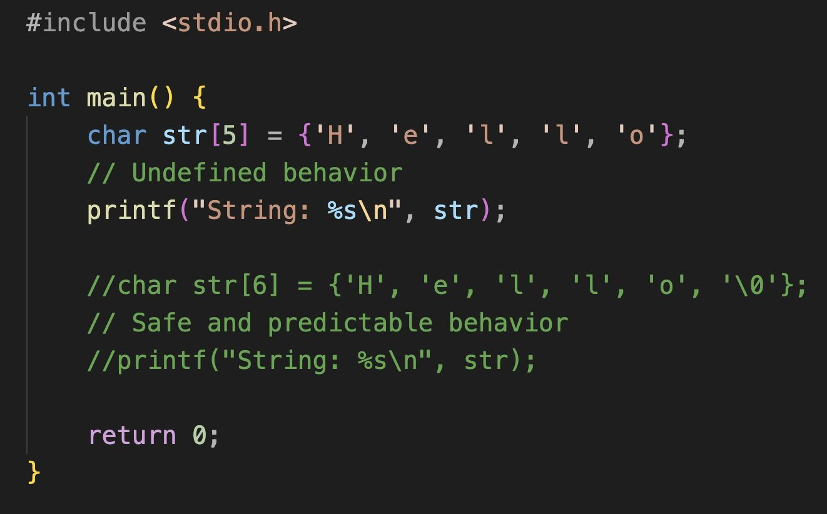
In-Class Activity
Common Bugs - Null Bytes
Since our string is not null-terminated, it may print garbage values or even crash the program.
Notes:
Common Bugs - Null Bytes
Risk: Failing to null-terminate a string can lead to printing "garbage" values or program crashes.
See example:
hello_string.c
---
Long-form Description:
Null Terminator Importance
This image displays a C source code snippet that contrasts incorrect and correct ways to initialize a character array for use as a string.
The code is written inside a main() function and includes the <stdio.h> library.
The Problem (Undefined Behavior):
The first example declares a character array char str[5] containing the characters 'H', 'e', 'l', 'l', 'o’.
A comment explicitly labels this as "Undefined behavior" because the array lacks a null terminator.
When printf attempts to print this using %s, it will continue reading past the end of the array into adjacent memory
until it happens to find a null byte, potentially causing a crash or displaying "garbage" data.
The Solution (Safe Behavior):
The second example, shown in comments, demonstrates the correct approach: char str[6] = {'H', 'e', 'l', 'l', 'o', '\0’}.
By increasing the array size to 6, the code accommodates the null terminator (\0).
A comment identifies this as "Safe and predictable behavior"
because the null terminator provides a clear "stop signal" for string-handling functions.

Slide 9
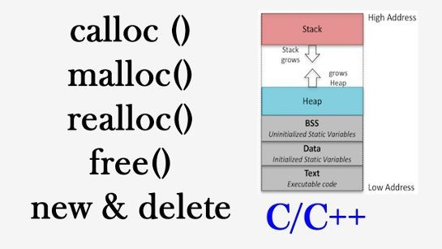
Dynamic Memory Allocation
Dynamic memory allocation in C and C++ allows programs to allocate memory during runtime rather than compile time. This enables flexible memory management, allowing you to create, resize, and deallocate memory as needed.
Two fundamental operators for dynamic memory allocation are malloc (in C) and new (in C++).
Similarly, deallocation is done using free (in C) and delete (in C++).
malloc: Allocates a specified number of bytes of memory.
free: Releases the dynamically allocated memory.
Image credit - Dynamic memory allocation in C and C++, Techdose @ YouTube
Notes:
Dynamic Memory Allocation
Runtime Allocation:
Allows memory to be allocated during execution rather than at compile time.
Flexibility:
Enables creating, resizing, and deallocating memory as needed.
Operators (C vs. C++):
Use malloc and free in C;
Use new and delete in C++.

Slide 10
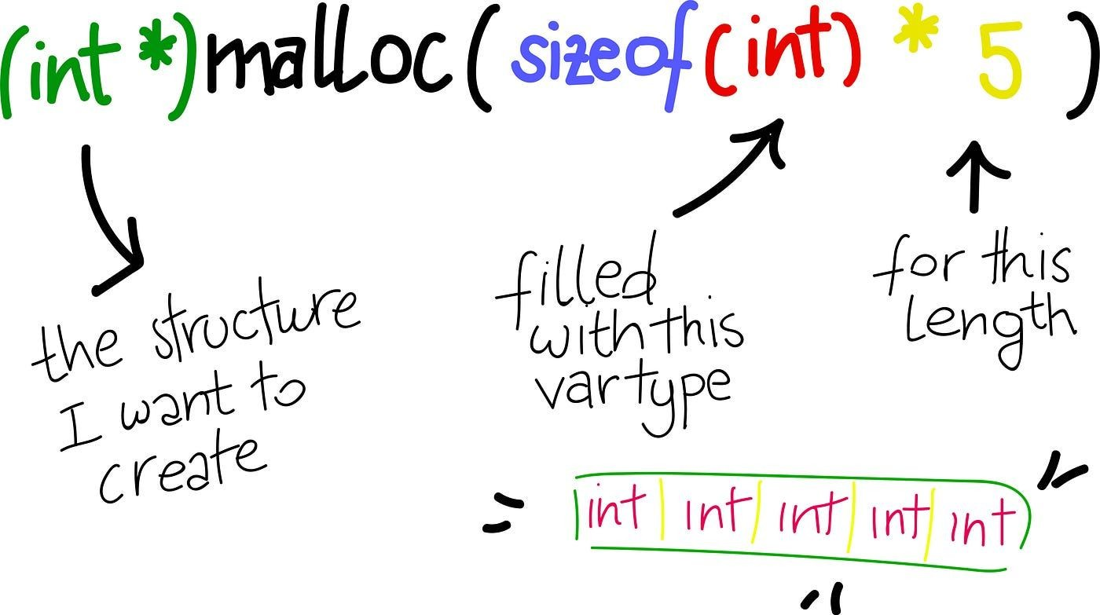
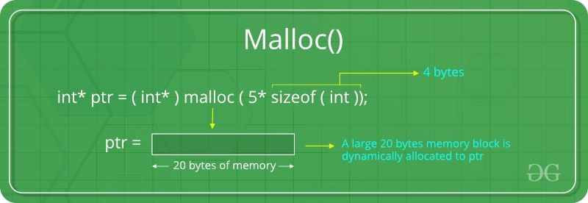
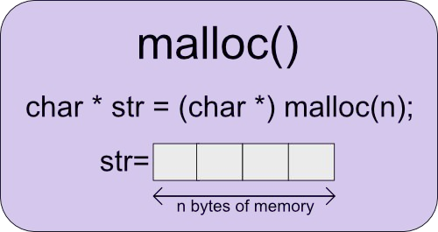
Dynamic Memory Allocation malloc()
Image credit - Zihan @ Medium
Image credit - https://www.geeksforgeeks.org/
Image credit - https://iq.opengenus.org/
Notes:
malloc(): Allocates a specific number of bytes.

Slide 11
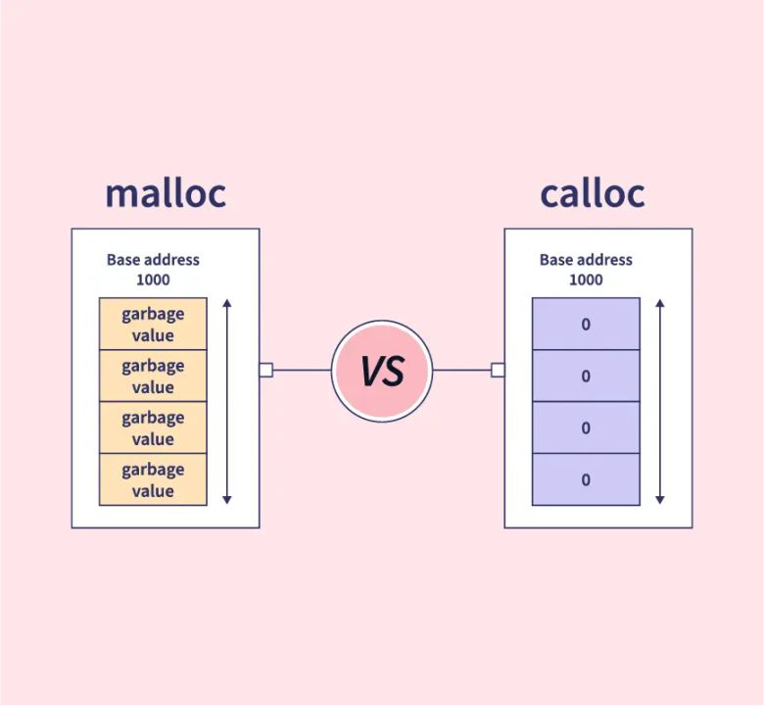
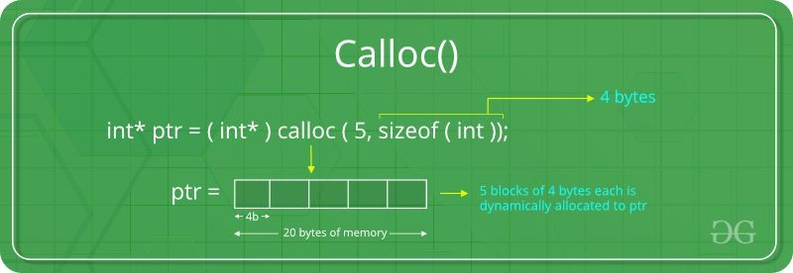
Dynamic Memory Allocation calloc()
Image credit - https://www.geeksforgeeks.org/
Notes:
calloc(): An alternative allocation method often used for arrays.

Slide 12
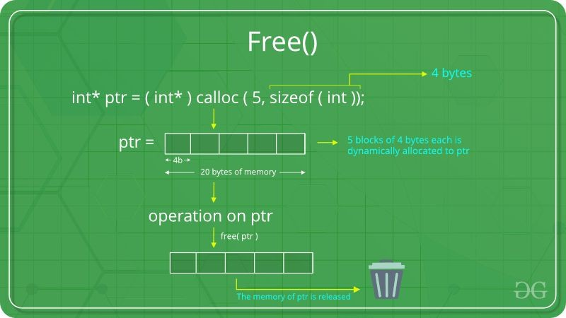
Dynamic Memory Allocation free()
Image credit - https://www.geeksforgeeks.org/
Notes:
free(): Releases previously allocated dynamic memory back to the system.

Slide 13
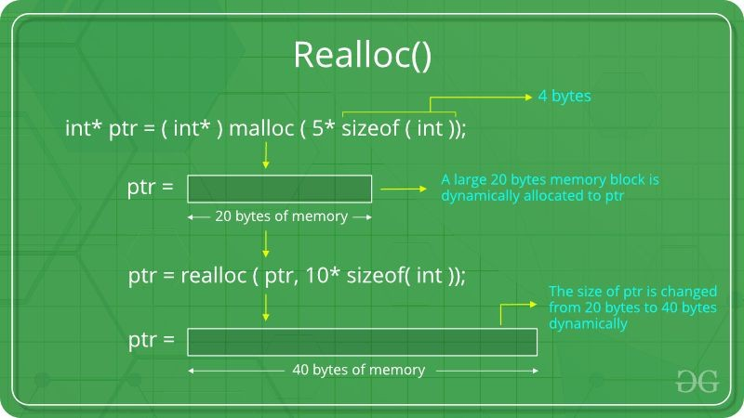
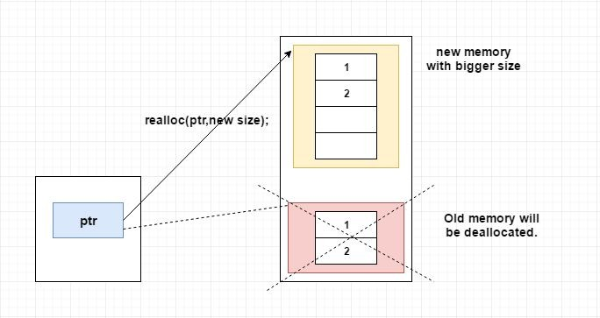
Dynamic Memory Allocation realloc()
Image credit - https://www.geeksforgeeks.org/
Image credit - https://www.log2base2.com/
Notes:
realloc(): Used to resize previously allocated memory blocks.

Slide 14
Dynamic Memory Allocation (revisited)
Dynamic memory allocation in C and C++ allows programs to allocate memory during runtime rather than compile time. This enables flexible memory management, allowing you to create, resize, and deallocate memory as needed.
Two fundamental operators for dynamic memory allocation are malloc (in C) and new (in C++).
Similarly, deallocation is done using free (in C) and delete (in C++).
malloc: Allocates a specified number of bytes of memory.
free: Releases the dynamically allocated memory.
In C and C++, memory is not automatically assigned or deallocated for variables or objects.
Instead, the programmer is responsible for managing memory explicitly. Memory is typically allocated and deallocated using functions or operators specifically designed for this purpose.
Image credit - Dynamic memory allocation in C and C++, Techdose @ YouTube
Notes:
Summary: Re-emphasizes that programmers are responsible for explicit memory management in C/C++.

Slide 15
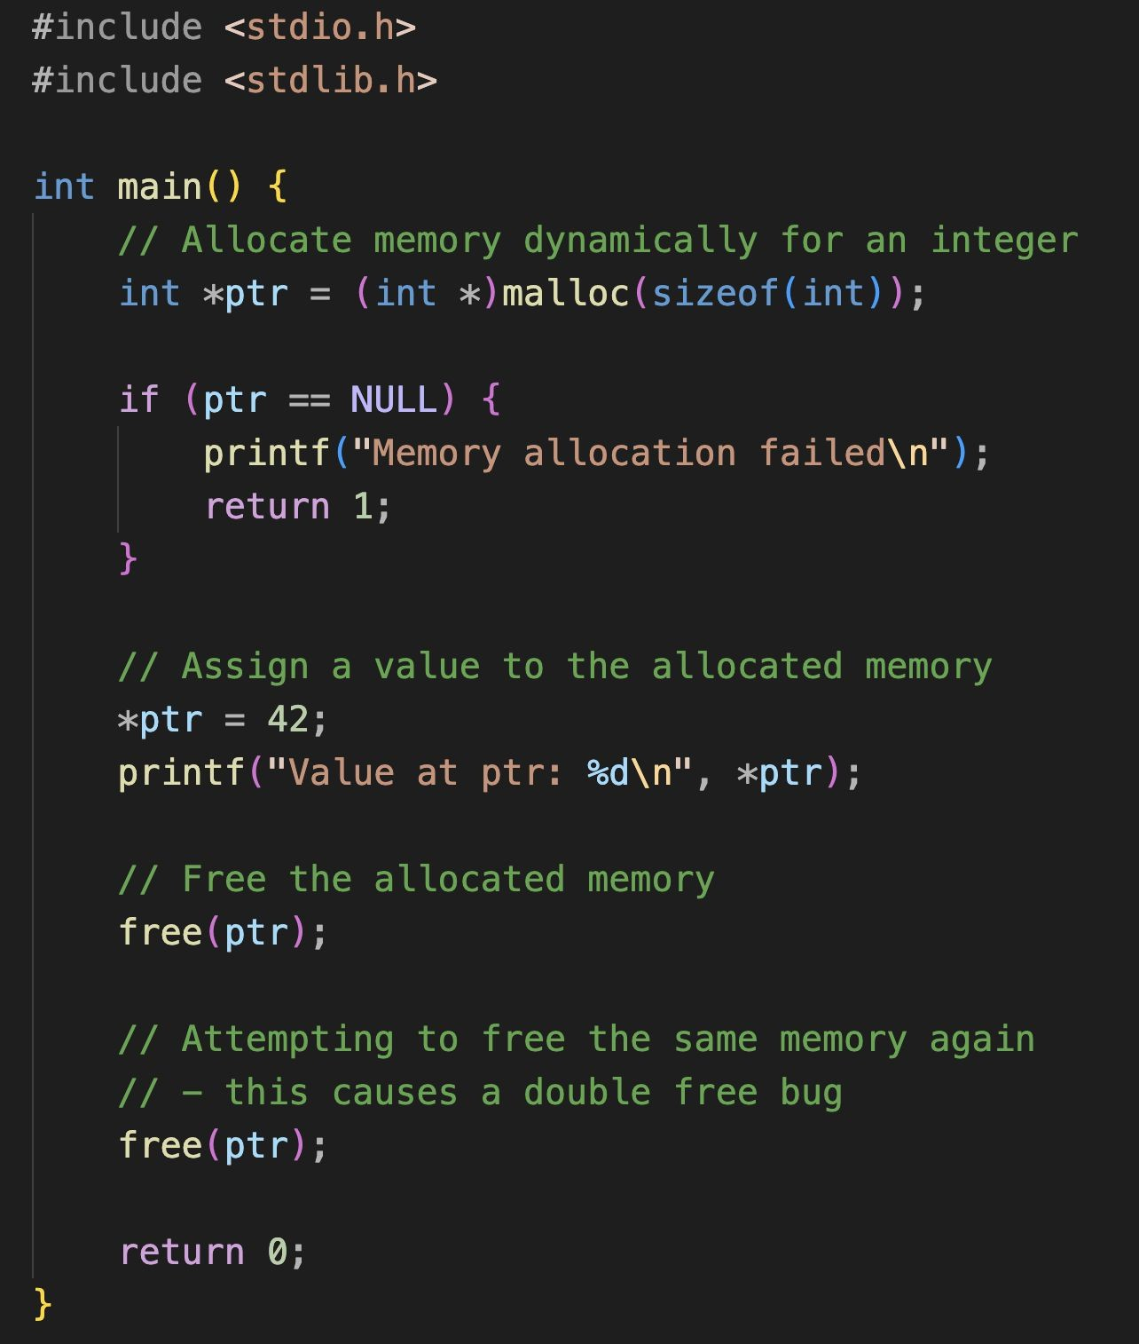
In-Class Activity Common Bugs - Double Frees
A double-free bug occurs when a program attempts to free a dynamically allocated memory block that has already been freed.
This can lead to various issues, including memory corruption and program crashes. Proper memory management is crucial to avoid double-free bugs in C.
We allocate memory for an integer using the malloc function.
After using the allocated memory, we free it using the free function.
However, there is an attempt to free the same memory block again, resulting in a double-free bug.
Notes:
Common Bugs - Double Frees
Definition:
Occurs when a program tries to free the same memory block more than once.
Consequences:
Leads to memory corruption and crashes.
See example:
double_frees.c

Slide 16
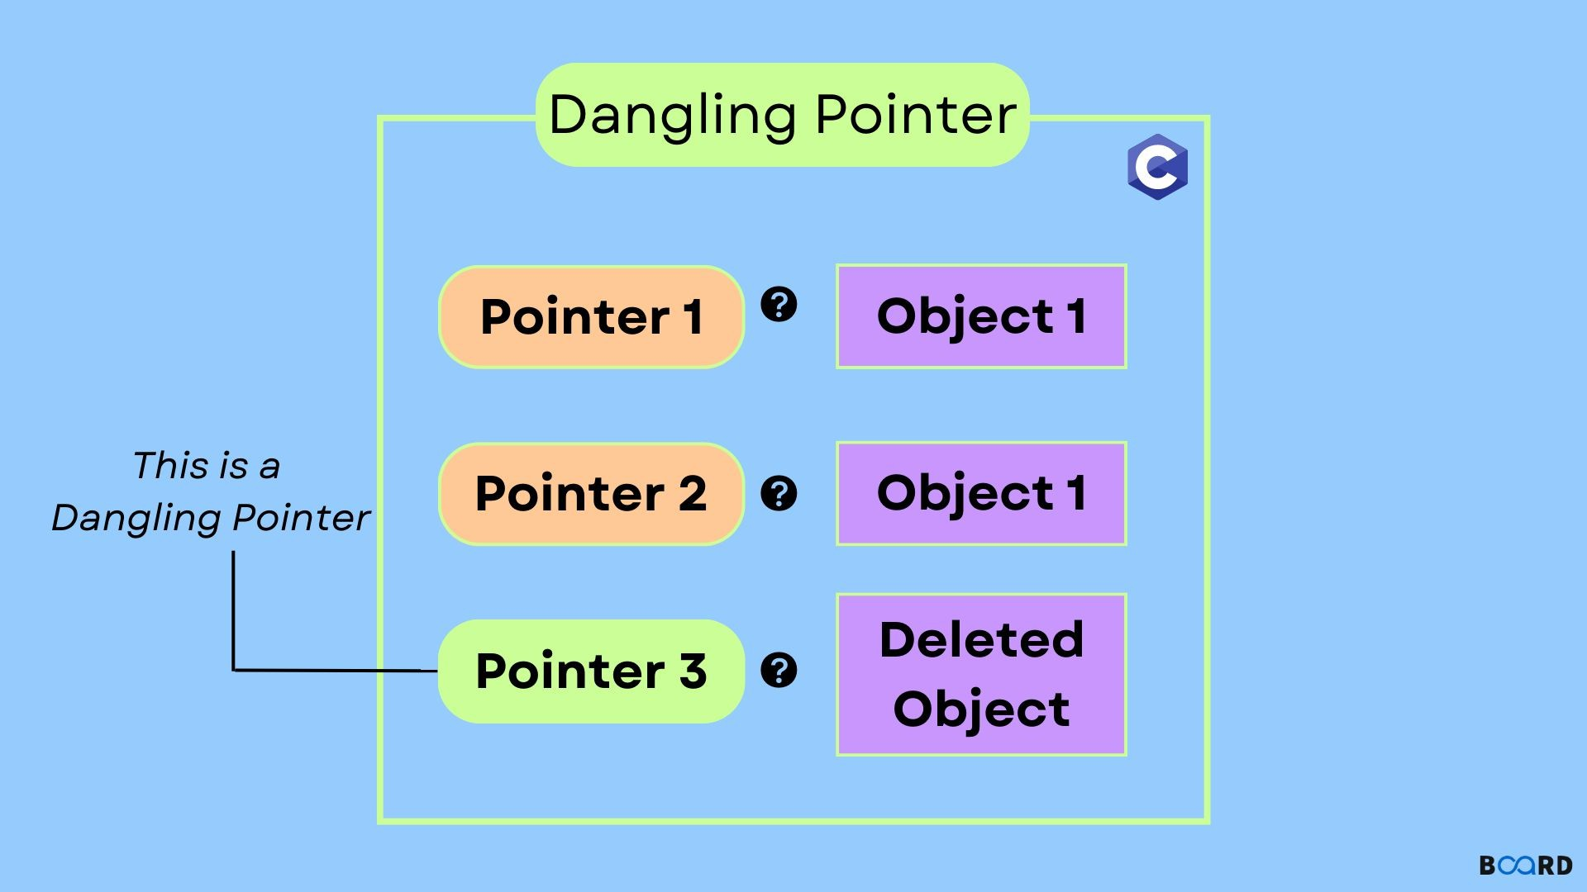
Dangling Pointers
Occur when memory is freed but the pointer is not set to NULL.
Using a dangling pointer leads to undefined behavior.
Image credit - https://www.boardinfinity.com/
Notes:
Dangling Pointers
Definition:
A pointer that still holds a memory address after that memory has been freed.
Risk:
Accessing it leads to undefined behavior.

Slide 17
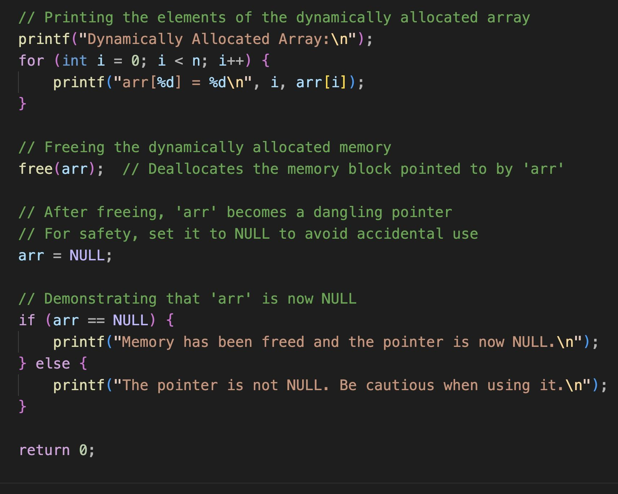
Dangling Pointers Solutions
Handling Dangling Pointers:
After calling free, the pointer arr still holds the memory address of the freed memory, which is now invalid. Accessing this memory can lead to undefined behavior.
To prevent this, it's a good practice to set the pointer to NULL after freeing the memory. This makes it clear that the pointer no longer points to a valid memory block.
Notes:
Best Practice:
Always set a pointer to NULL immediately after calling free() to indicate it no longer points to valid memory.
See example:
dangling_pointers.c
dangling_pointers_2.c

